Slide 1







Kathmandu Renting
Market Analysis

Slide 2
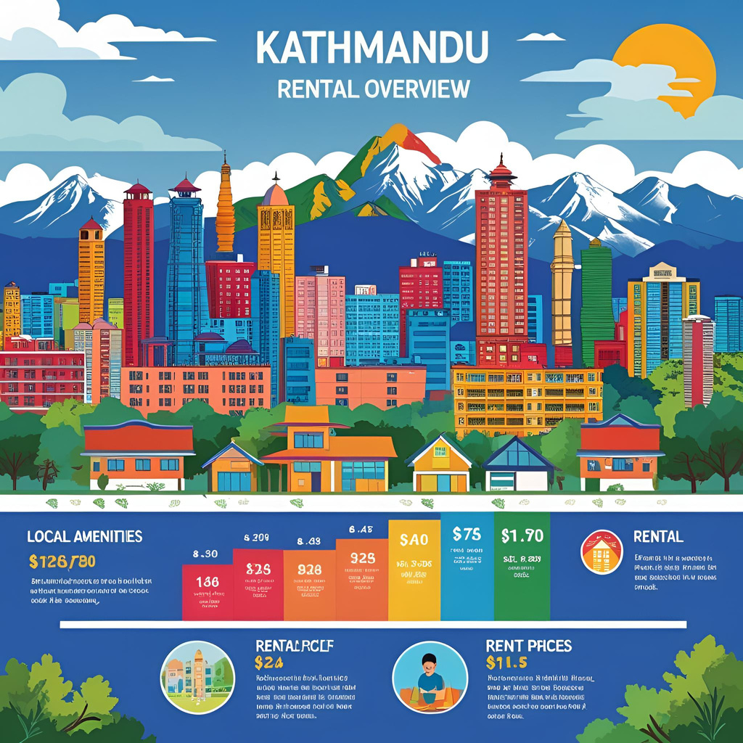
App Overview
The Kathmandu House Price Predictor App is a web-based tool designed to estimate property values using machine learning.
Developed using Streamlit
Predicts house pricing based on:
1.Rooms
2.Area (sq.ft.)
3.Location
Integrates local pricing metrics like Price per Aana, Electricity Bill, and Land Cost

Slide 3


Problem Statement
No easy way to estimate home costs in Kathmandu’s local context,
Buyers struggle with:
Lack of transparent cost breakdowns
No localized tools with room, area & utility logic
Homebuyers: Informed decisions
Real Estate Agents: Quick estimates
Investors: Market analysis

Slide 4






Cost Breakdown
Land Cost
Electricity Bill
Area (aana) × Land Price per Aana
First 3 digits of Area Increment (no decimal)
Area Price Increment
Price per room
(Areainsq.ft.÷100)×(LandPrice÷342.25)
(price_per_aana / 342.25) per 100 sq.ft.+Electricity bill

Slide 5
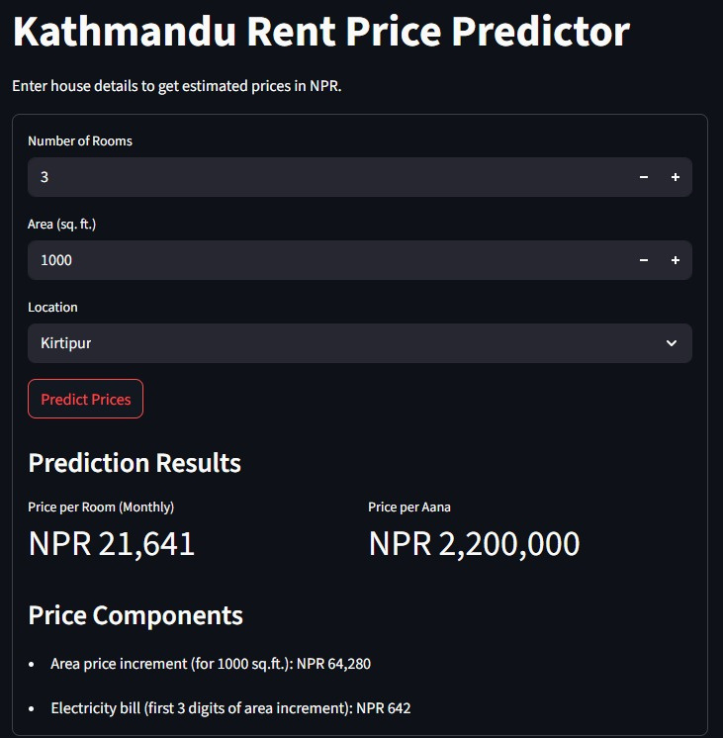
Screenshot of our app's output section after a prediction
No. of Rooms: 3
Area: 1000 sq.ft.
Location: Kirtipur
Price/Room: NPR 21,641(Including Electricity Bill)
Price/Aana: NPR 2,200,000

Slide 6

Math And Pricing: Linear Regression
Predicted Price=β0​+β1​×(Rooms)+β2​×(Area)+β3​×(Location Index)
Rooms: Number of rooms
Area: Total square feet
Location Index: A numeric representation of land value by location
Our core prediction model leverages a
multiple linear regression algorithm,
combining key property attributes to estimate market price

Slide 7

Next Steps & Future Vision
01
Enhance Model
Integrate more features like age of property, construction Costs, and market trends.
Mobile App
02
Develop native iOS and Android applications for wider accessibility.
03
Expand Locations
Include other major cities in Nepal and potentially beyond.
04
Partnerships
Collaborate with local real estate agencies and financial institutions.

Slide 8

Thank You
For Your Attention
Link For App

